Slide 1


Slide 2
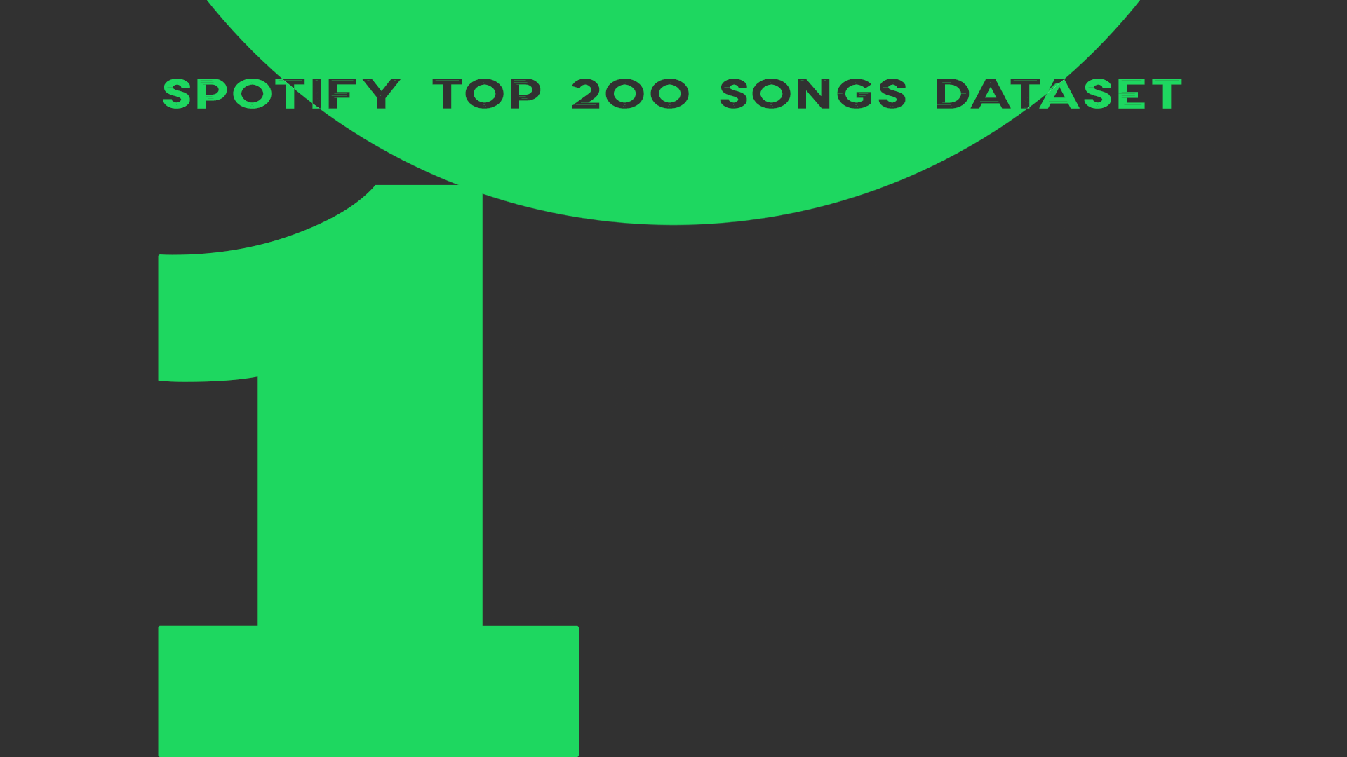
https://www.kaggle.com/datasets/yelexa/spotify200?resource=download

Slide 3


Slide 4
